Slide 1




CONSUMER GOODS AD-HOC INSIGHTS
Created By: Rajvardhan Singh Parmar

Slide 2
OBJECTIVES
AtliQ Hardware, a fictitious corporation, distinguishes itself as a prominent computer hardware manufacturer in India with a strong global presence.
Despite its prominence, the management acknowledges the necessity for more timely and well-informed decisions supported by data insights.
A strategic initiative is underway to strengthen the data analytics team through the recruitment of junior data analysts.
To thoroughly assess potential candidates, Tony Sharma, the Director of Data Analytics, intends to orchestrate an SQL challenge, gauging both technical skills and soft skills.
The company has identified 10 specific ad hoc requests for which they are seeking valuable insights.

Slide 3
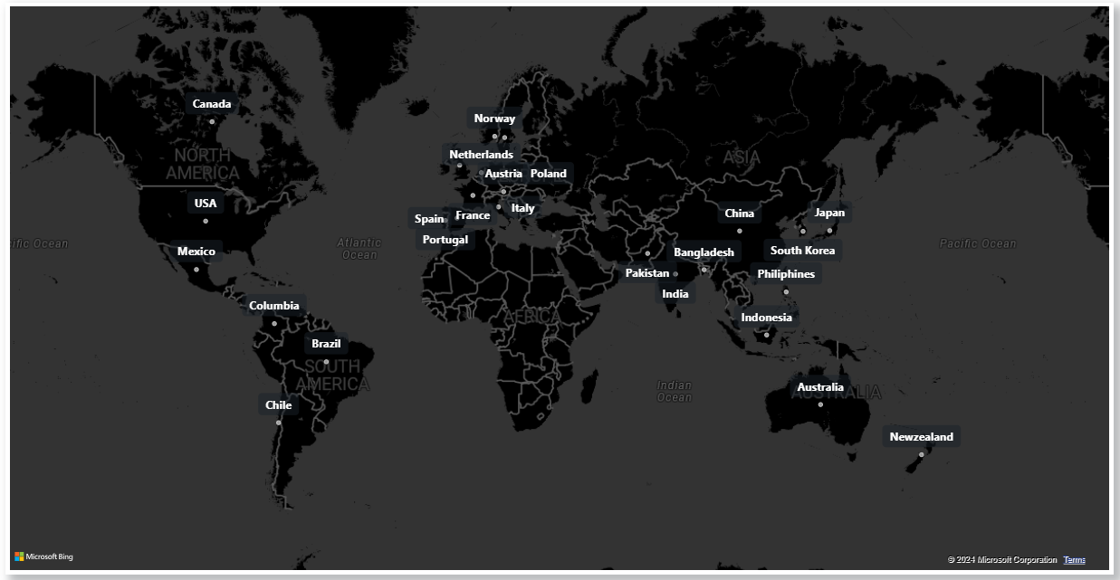
ATLIQ’S MARKETS

Slide 4
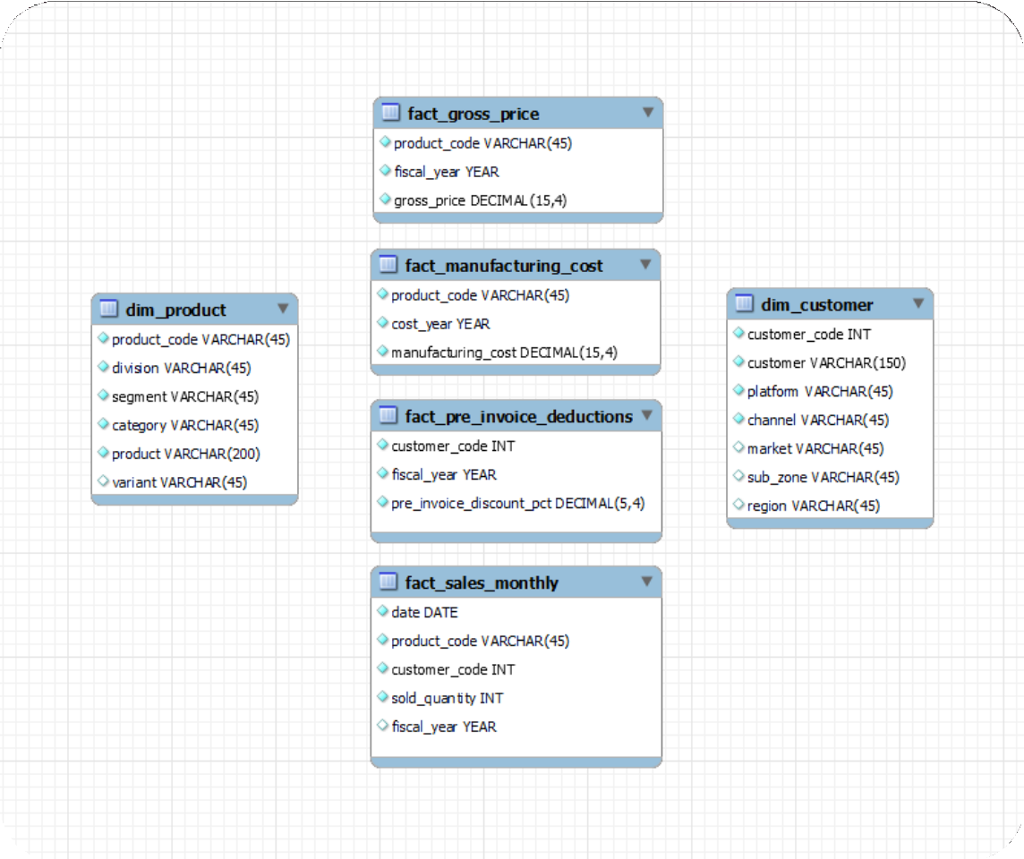
INPUT DATA

Slide 5
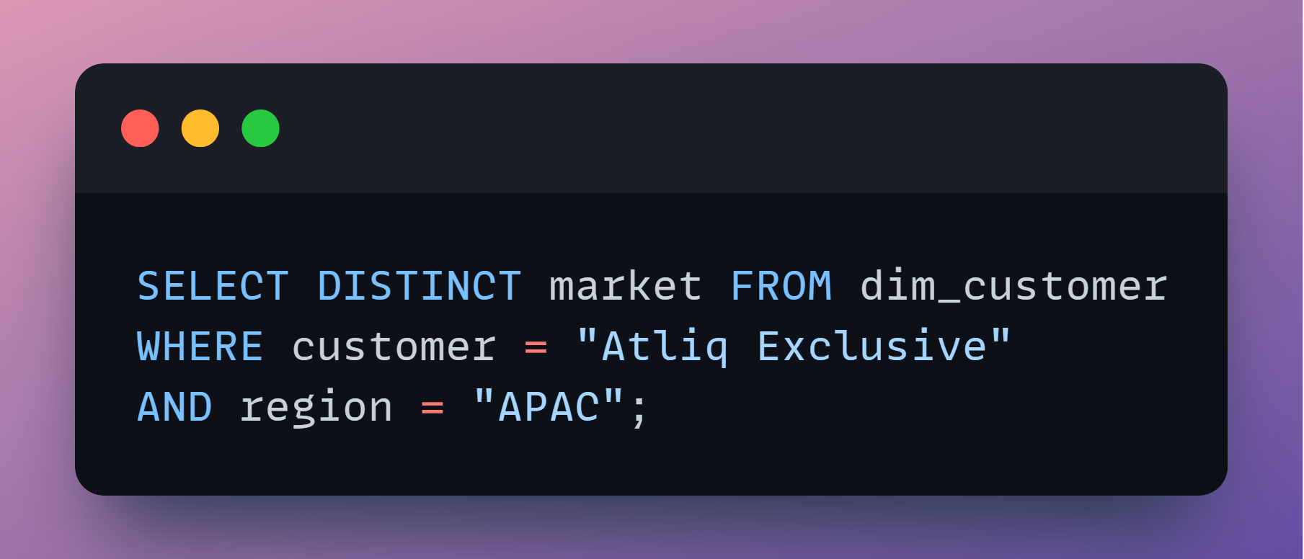
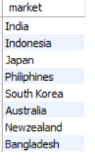
AD-HOC REQUEST 1
=> Provide the list of markets in which customer "AtliQ Exclusive" operates its business in the “APAC” region
SQL QUERY
OUTPUT

Slide 6
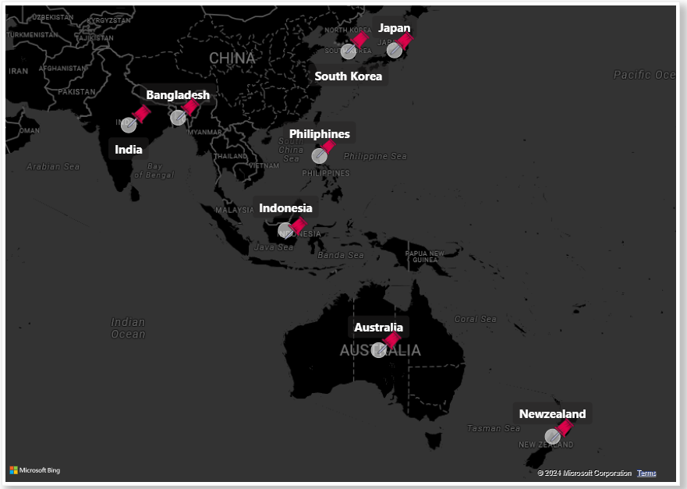

CONVERSION OF OUTPUT TO VISUAL AND INSIGHTS
Our “AtliQ Exclusive” store has successfully established its footprint in 8 key markets within the APAC region.

Slide 7
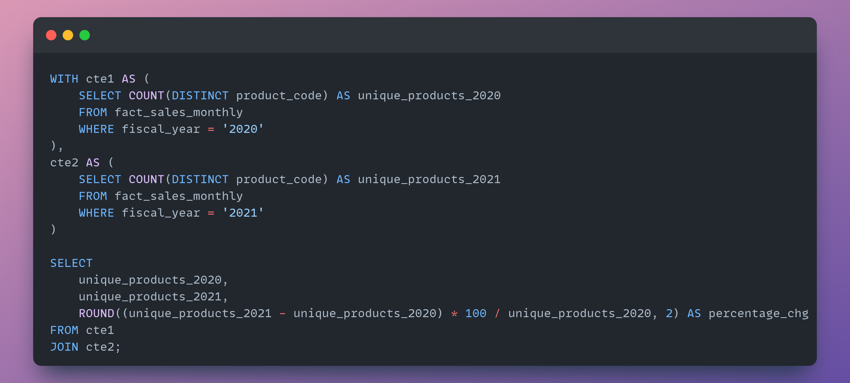
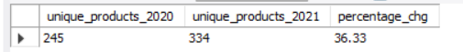
AD-HOC REQUEST 2
=> What is the percentage of unique product increase in 2021 vs. 2020? The final output contains these fields, unique_products_2020 unique_products_2021 percentage_chg
SQL QUERY
OUTPUT

Slide 8
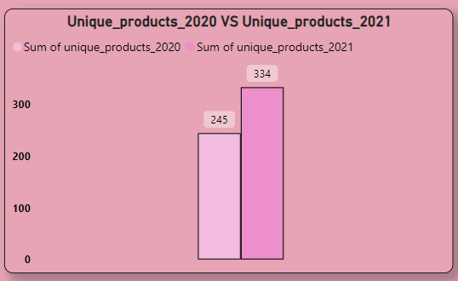
CONVERSION OF OUTPUT TO VISUAL AND INSIGHTS
36%
We're positively demonstrating ongoing innovation, introducing new products consistently. In FY 2020, we had 245 products, but in FY 2021, the count surged by 36% to reach 334 products.

Slide 9
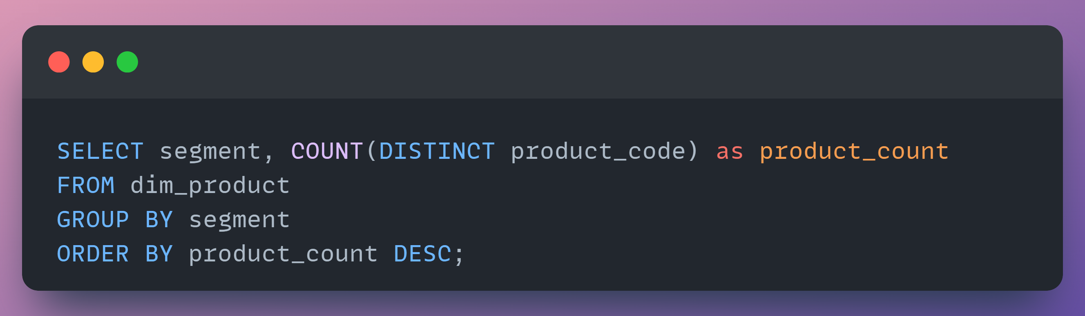
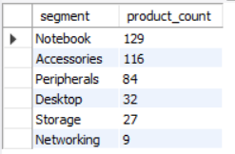
=> Provide a report with all the unique product counts for each segment and sort them in descending order of product counts. The final output contains 2 fields, segment product_count
AD-HOC REQUEST 3
SQL QUERY
OUTPUT

Slide 10
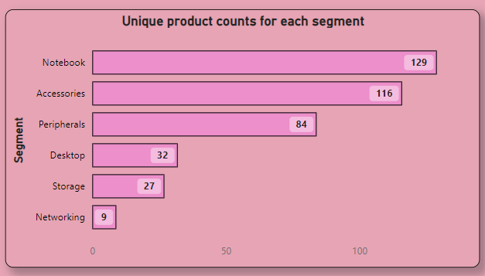
CONVERSION OF OUTPUT TO VISUAL AND INSIGHTS
Segments such as notebooks, accessories, and peripherals are experiencing notable manufacturing expansion when contrasted with desktops, storage, and networking.
Notebooks, accessories, and peripherals make up 83% of the total manufactured products.

Slide 11
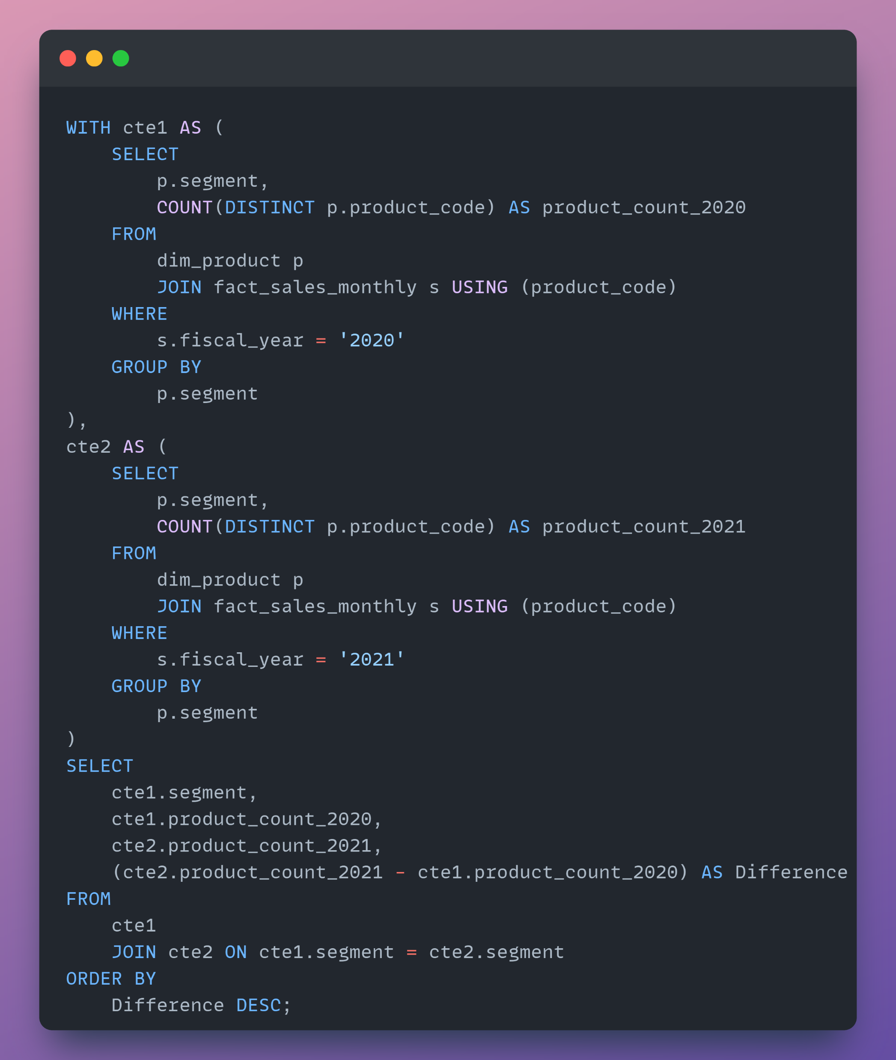
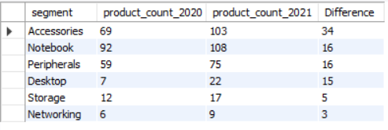
=> Follow-up: Which segment had the most increase in unique products in 2021 vs 2020? The final output contains these fields, segment product_count_2020 product_count_2021 difference
AD-HOC REQUEST 4
SQL QUERY
OUTPUT

Slide 12
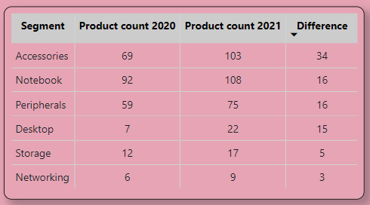
CONVERSION OF OUTPUT TO VISUAL AND INSIGHTS
Accessories saw the most significant rise in production.
Storage and networking are undergoing slower growth compared to other segments.

Slide 13
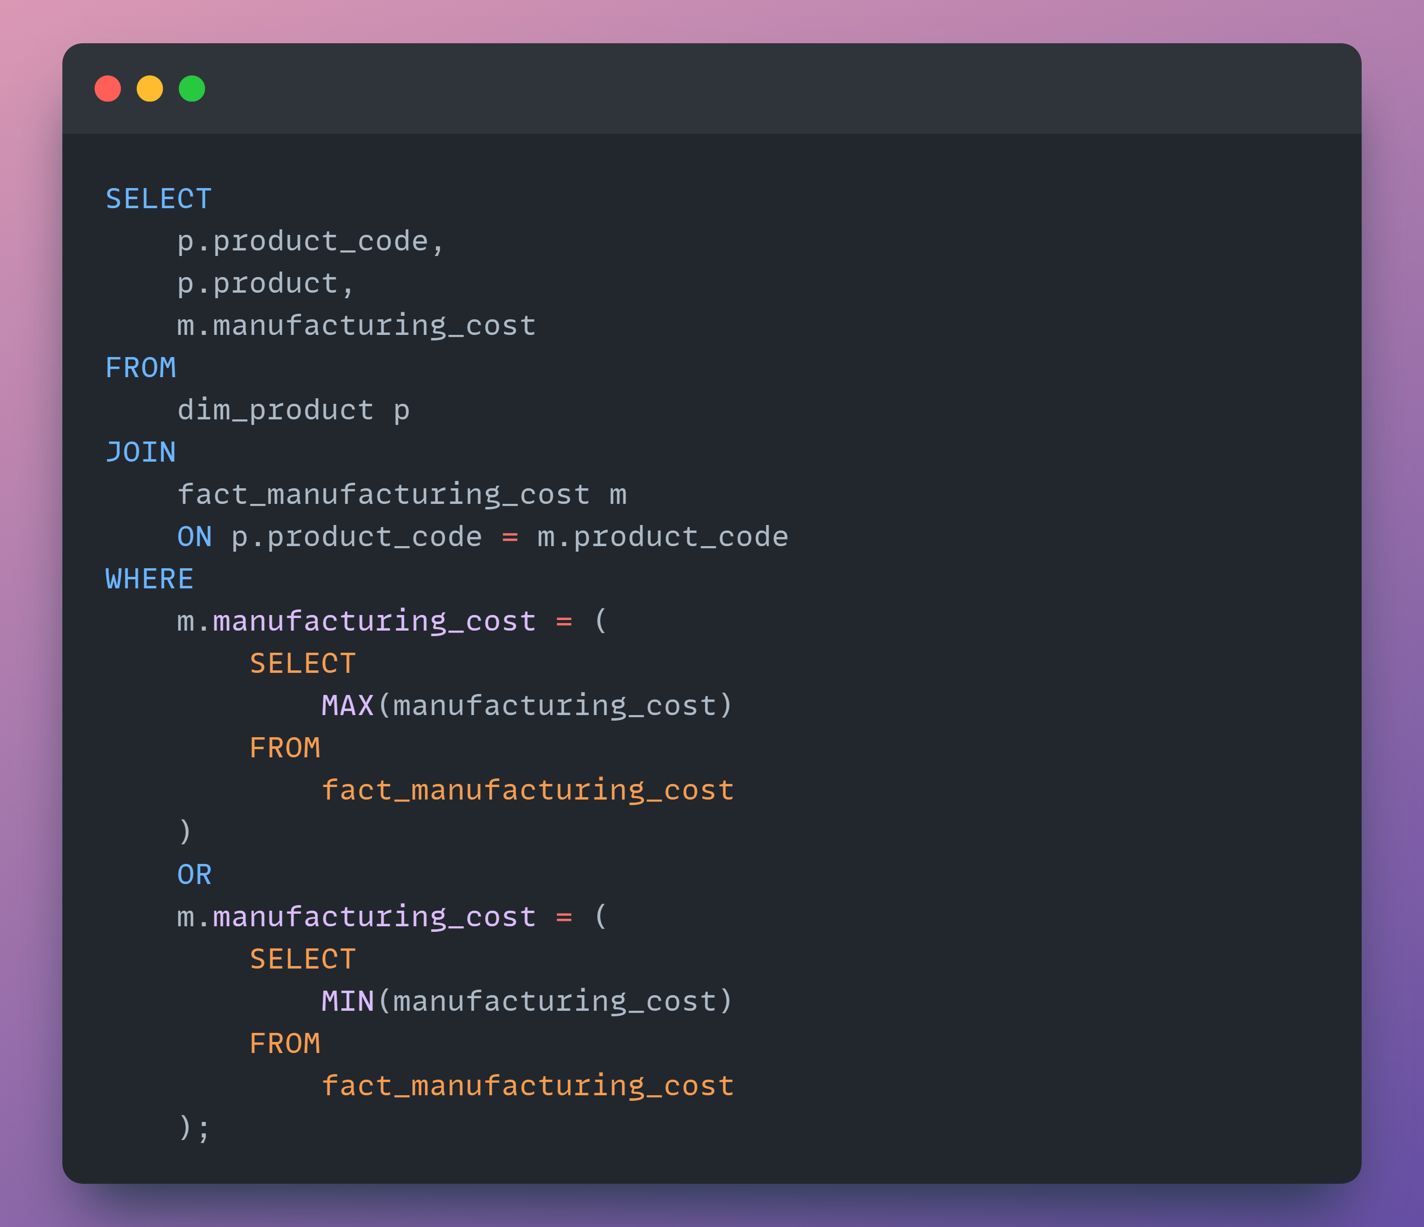
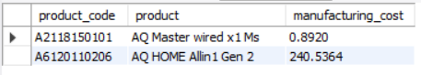
=> Get the products that have the highest and lowest manufacturing costs. The final output should contain these fields, product_code product manufacturing_cost
AD-HOC REQUEST 5
SQL QUERY
OUTPUT

Slide 14
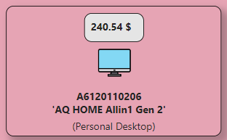
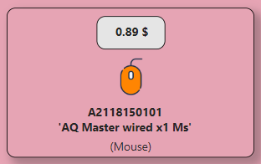
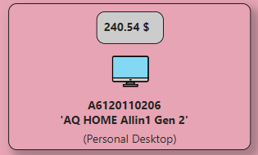
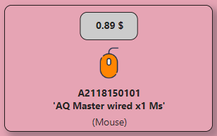
CONVERSION OF OUTPUT TO VISUAL AND INSIGHTS
HIGHEST
LOWEST
The AQ Home Allin1 Gen2 (Variant: Plus 3)
Personal desktop has the highest manufacturing cost.
The AQ Master wired x1 Ms (Variant: Standard 1)
Mouse incurs the lowest manufacturing cost.

Slide 15
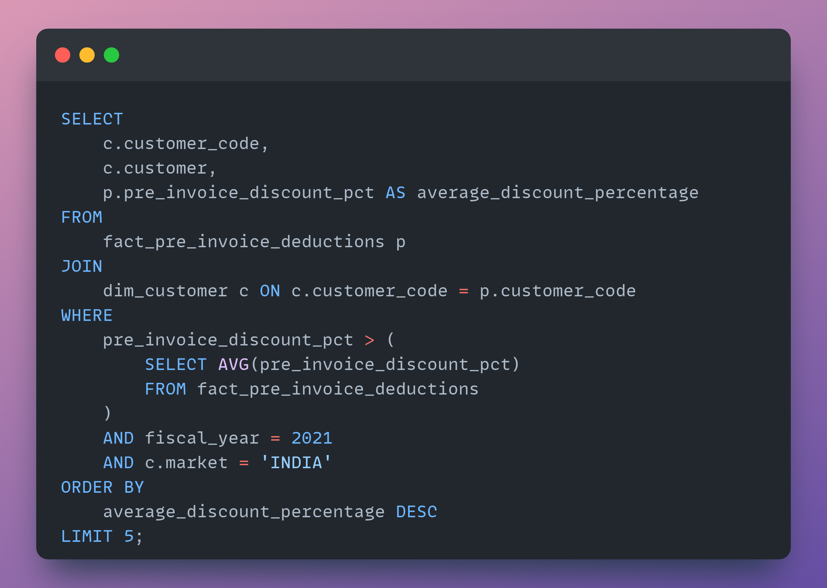
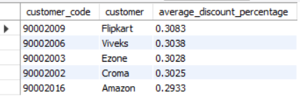
=> Generate a report which contains the top 5 customers who received an average high pre_invoice_discount_pct for the fiscal year 2021 and in the Indian market. The final output contains these fields, customer_code customer average_discount_percentage
AD-HOC REQUEST 6
SQL QUERY
OUTPUT

Slide 16
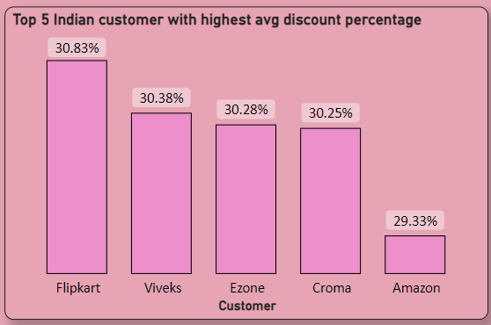
CONVERSION OF OUTPUT TO VISUAL AND INSIGHTS
Flipkart received the highest average pre-invoice discount.
Amazon received the lowest average pre-invoice discount.

Slide 17
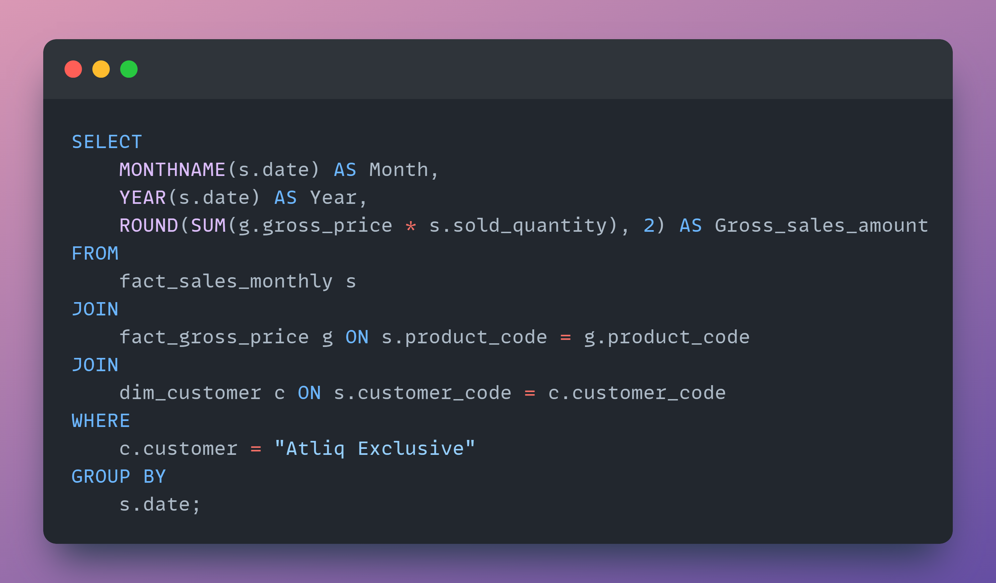
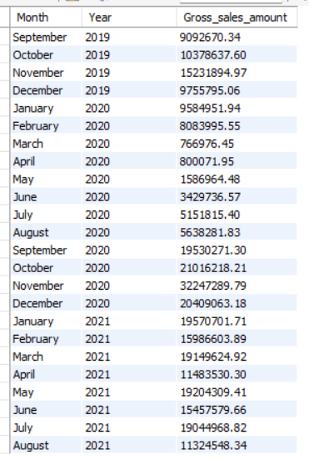
=> Get the complete report of the Gross sales amount for the customer “Atliq Exclusive” for each month. This analysis helps to get an idea of low and high-performing months and make strategic decisions. The final report contains these columns: Month, Year Gross sales Amount
AD-HOC REQUEST 7
SQL QUERY
OUTPUT

Slide 18
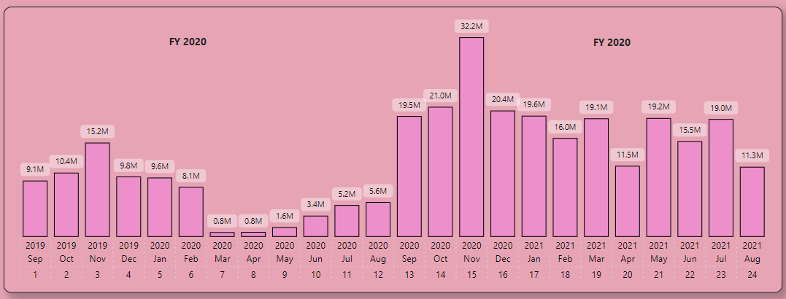
CONVERSION OF OUTPUT TO VISUAL AND INSIGHTS
AtliQ Exclusive sold the most stuff in November 2020 and the least in March 2020.
Sales dropped from March to August because of COVID-19. But now, things are looking up. Sales have been going up and are even better than they were in 2020.

Slide 19
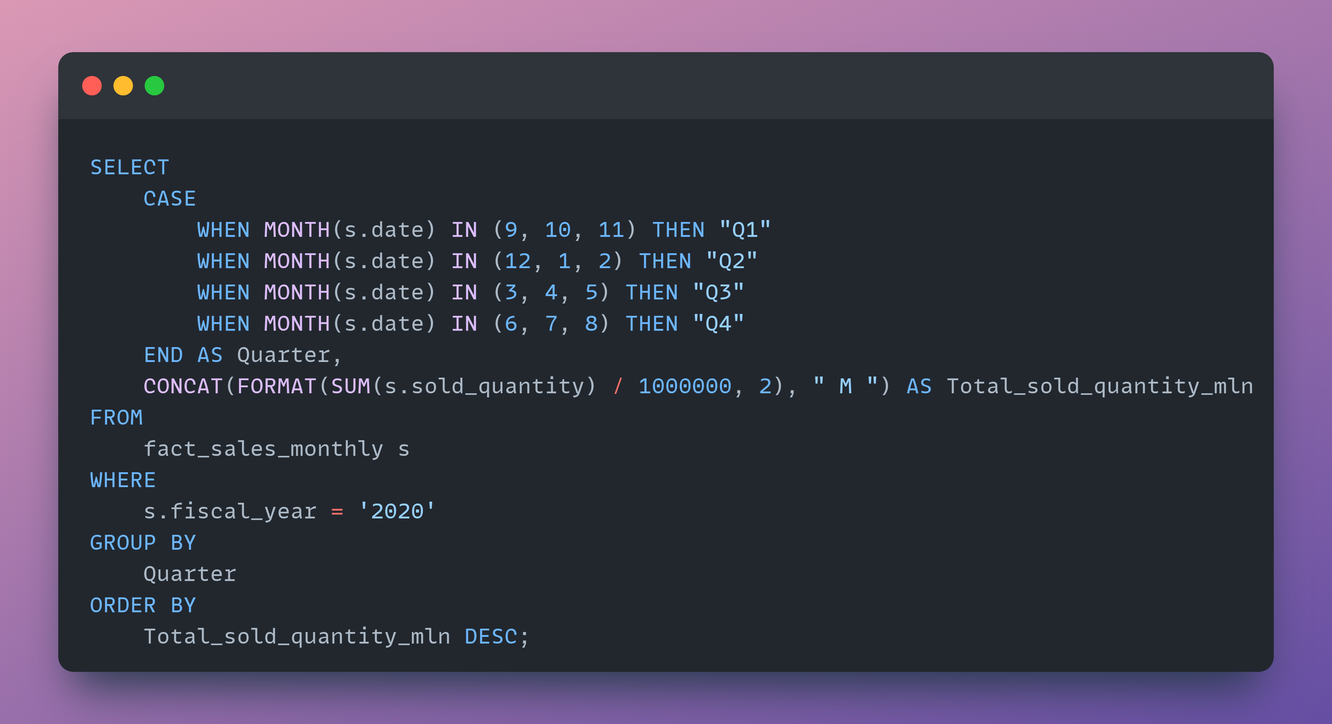
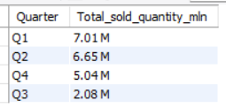
=> In which quarter of 2020, get the maximum total_sold_quantity? The final output contains these fields sorted by the total_sold_quantity, Quarter total_sold_quantity _mln
AD-HOC REQUEST 8
SQL QUERY
OUTPUT

Slide 20
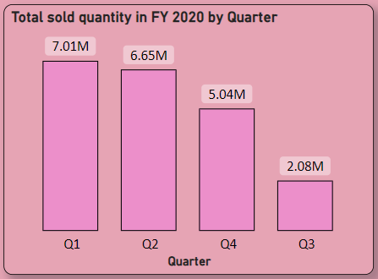
CONVERSION OF OUTPUT TO VISUAL AND INSIGHTS
The highest number of units sold across all quarters occurred in Quarter 1 of FY 2020, whereas Quarter 3 recorded the lowest sales.
Approximately 34% of the total quantity sold in FY 2020 is attributed to Quarter 1.

Slide 21
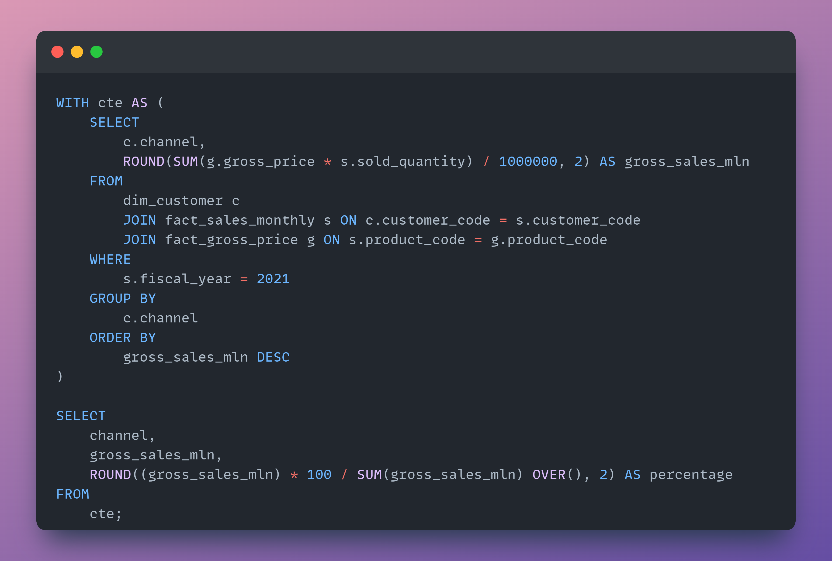
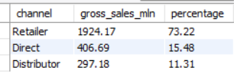
=> Which channel helped to bring more gross sales in the fiscal year 2021 and the percentage of contribution? The final output contains these fields, channel gross_sales_mln percentage
AD-HOC REQUEST 9
SQL QUERY
OUTPUT

Slide 22
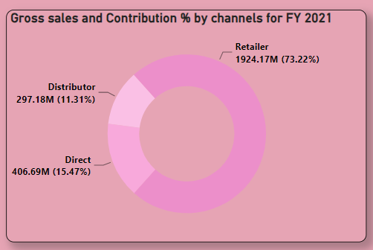
CONVERSION OF OUTPUT TO VISUAL AND INSIGHTS
Most of our sales occurred through Retailer, constituting 75% of the overall sales. Only a minimal portion of our sales occurred directly and via distributor channels.

Slide 23
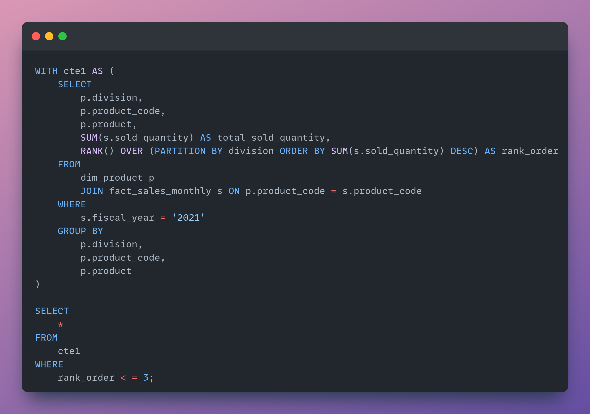
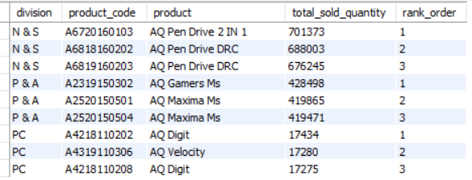
=> Get the Top 3 products in each division that have a high total_sold_quantity in the fiscal_year 2021? The final output contains these fields, division product_code product total_sold_quantity rank_order
AD-HOC REQUEST 10
SQL QUERY
OUTPUT

Slide 24
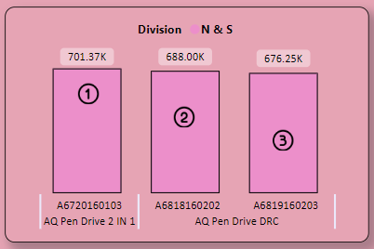
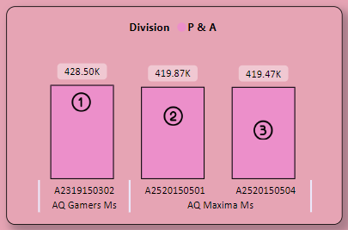
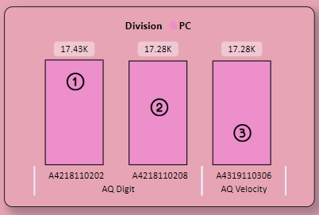
CONVERSION OF OUTPUT TO VISUAL AND INSIGHTS
The leading three products in N & S were Pen drives, with a total quantity sold of approximately 700,000 units.
The leading three products in P & A were Mouse, with a total quantity sold of approximately 400,000 units.
The leading three products in P & C were Personal Laptops, with a total quantity sold of approximately 17,000 units.

Slide 25

.

